Slide 1
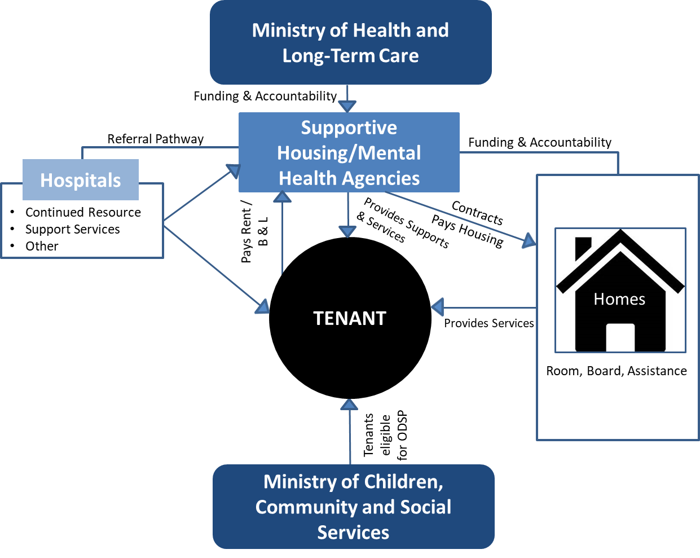
Overview: Modernized Approach
Supportive Housing/Mental Health Agencies (Agency) will become a new local partner in provision of supports and services to HSC tenants
HSC tenants will now receive supports and services that other supportive housing tenants receive (this includes support services that would assist people to live as independently as possible)
The Agency will enter into a funding Agreement with MOHLTC
The Agency in turn would enter into an agreement with the HSC owner
Multi-year agreements replace licensing under the HSC Act
The modernized program to be administered like other supportive housing programs, through agreements that set out operating requirements, standards and outcomes
Modernized program operates outside the Homes for Special Care Act with a new name the Community Homes for Opportunity program

